Slide 1
Oscillation
Oscillation: The incident in which a particle moves back and forth repeatedly is called oscillation.
Periodic/ Harmonic Motion: Any motion that repeats at regular intervals is called periodic motion or harmonic motion.
Simple Harmonic Motion (SHM): This is a particular type of periodic motion which is a sinusoidal function of time.
It can be written as a sine or a cosine of time t.

Slide 2


The displacement/ Position of a particle in SHM is,
$$x\left(t\right)=x_{m} cos⁡(ωt+φ)$$
As the value of a cosine varies between -1 and +1, the position of a particle in SHM varies between $−x_{m}$and $+x_{m}$

Slide 3
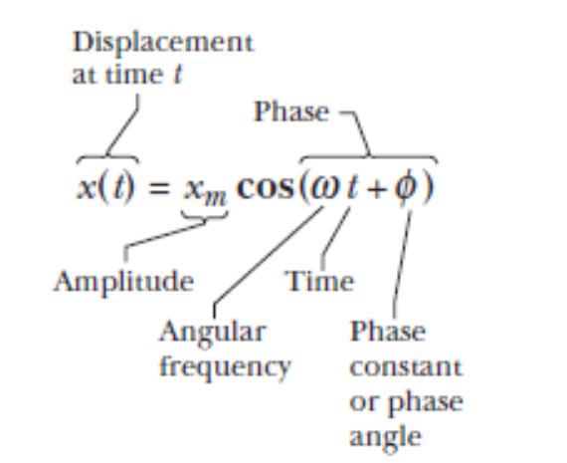

Amplitude($x_{m})$: The maximum displacement travelled by a particle in SHM is called the amplitude of oscillation.

Slide 4
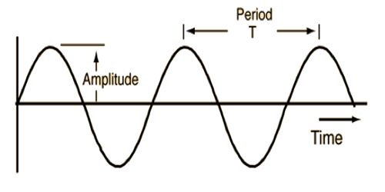

Frequency :
The frequency f of the oscillation is the number of times per second that it completes a full oscillation (a cycle) and has the unit of hertz (abbreviated Hz),
where 1 hertz = 1 Hz = 1 oscillation per second = 1 s ^{–1}
Time Period :
The time for one full cycle is the period T of the oscillation , which is
T = $\frac{1}{f}$

Slide 5





Angular Frequency $\left(ω=\frac{2π}{T}=2πf\right):$
The position of a particle at time t in a SHM,
$$x\left(t\right)=x_{m} cos⁡(ωt+φ)$$
And the position of a particle after a period T,
$$x\left(t+T\right)=x_{m} cos⁡(ω(t+T)+φ)$$
Now we have,
$x\left(t\right)=$ $x\left(t+T\right)$
$$⇒x_{m} cos⁡(ωt+φ)=x_{m} cos⁡(ω(t+T)+φ)$$
$$⇒cos⁡(ωt+φ)=cos⁡(ωt+φ+ωT)$$

Slide 6
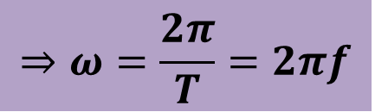


As a cosine function repeats itself by $2π$radian,
$$∴ωT=2π$$
$$⇒ω=\frac{2π}{T}=2πf$$
Unit: $rads^{−1}$

Slide 7
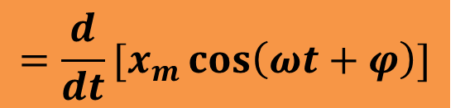
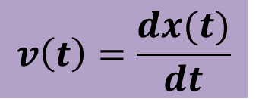

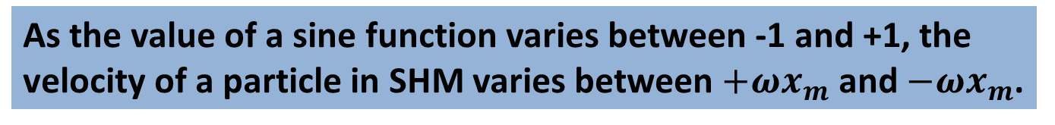

The Velocity of SHM:
$$v\left(t\right)=\frac{dx(t)}{dt}$$
$$=\frac{d}{dt}[x_{m}\cos\left(ωt+φ\right)]$$
$$∴v\left(t\right)=−ωx_{m}Sin(ωt+φ)$$
As the value of a sine function varies between -1 and +1, the velocity of a particle in SHM varies between $+ωx_{m}$ and $−ωx_{m}$.
So, the velocity amplitude,
$$v_{m}=ωx_{m}$$

Slide 8
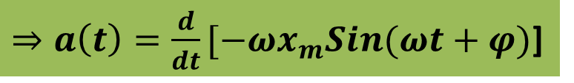
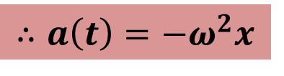
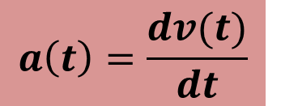


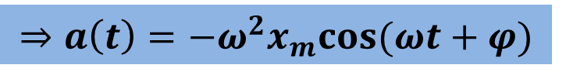
The Acceleration of SHM:
$$a\left(t\right)=\frac{dv(t)}{dt}$$
$⇒a\left(t\right)=\frac{d}{dt}[−ωx_{m}Sin(ωt+φ)$]
$$⇒a\left(t\right)=−ω^{2}x_{m}cos⁡(ωt+φ)$$
$$∴a\left(t\right)=−ω^{2}x$$
As the value of a cosine function varies between -1 and +1, the acceleration of a particle in SHM varies between $−ω^{2}x_{m}$and $+ω^{2}x_{m}$.
So, the acceleration amplitude,
$$a_{m}=ω^{2}x_{m}$$

Slide 10
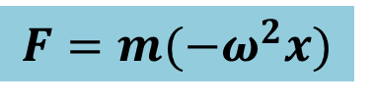

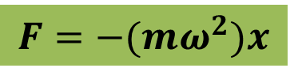
The Force law for SHM:
From Newton’s 2nd Law, the force responsible for SHM,
$$F=ma$$
$$F=m(−ω^{2}x)$$
$$F=−(mω^{2})x$$
Thus the force on a particle in SHM is a restoring force that acts opposite to the displacement of the particle.

Slide 11
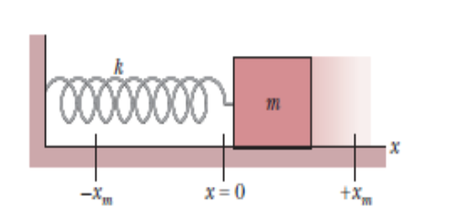



Period of a simple harmonic oscillator:
We consider a block-spring system which is called a linear simple harmonic oscillator.
From the force law,
$$F=−(mω^{2})x$$
Again from Hook’s law, $F=−kx$
$$∴k=mω^{2}$$

Slide 12
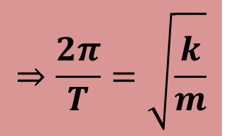
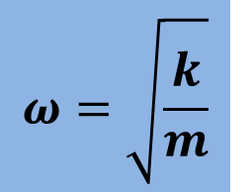
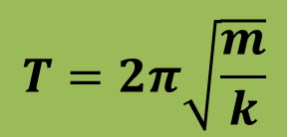
$$ω=\sqrt{\frac{k}{m}}$$
$$⇒\frac{2π}{T}=\sqrt{\frac{k}{m}}$$
$$T=2π\sqrt{\frac{m}{k}}$$
This is the period of the simple harmonic oscillator.

Slide 13
3 : What is the maximum acceleration of a platform that oscillates at amplitude 2.20 cm and frequency 6.60 Hz?
x_{m} = 2.20 cm = 0.0220 m
f = 6.60 Hz
a(t) = - ω² x_{m} cos (ωt + φ)
a_{m}= ω² x_{m} = (2πf )² x_{m} = 4π²( 6.60)²( 0.0220) = 37.8 m/s² = 37.8 m/s-s
x (t) = x_{m} cos (ωt + φ)
v(t) = - ω x_{m} sin (ωt + φ)

Slide 14

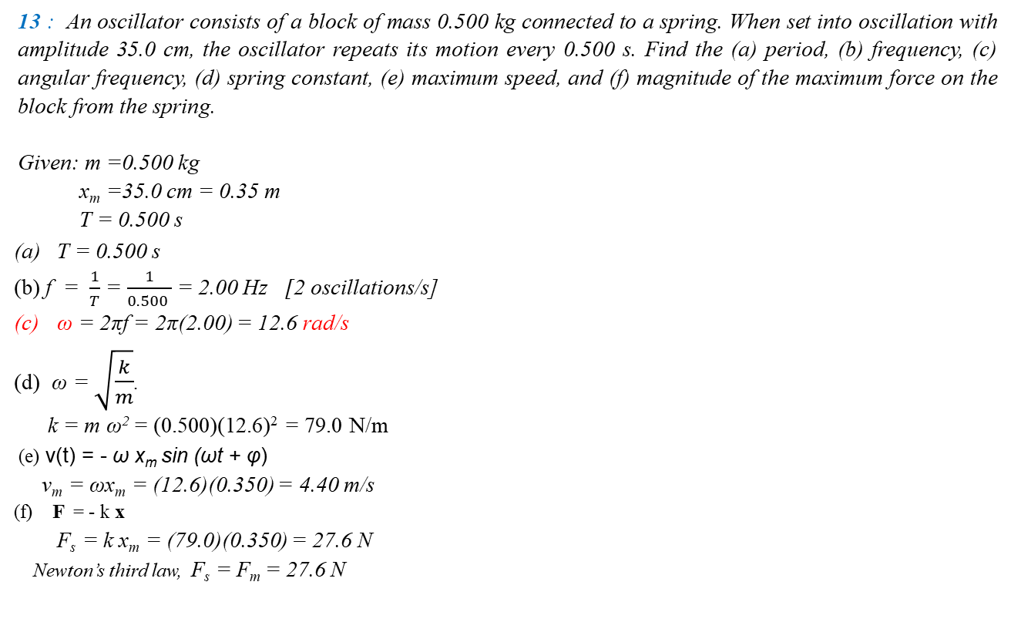
13 : An oscillator consists of a block of mass 0.500 kg connected to a spring. When set into oscillation with amplitude 35.0 cm, the oscillator repeats its motion every 0.500 s. Find the (a) period, (b) frequency, (c) angular frequency, (d) spring constant, (e) maximum speed, and (f) magnitude of the maximum force on the block from the spring.
Given: m =0.500 kg
x_{m} =35.0 cm = 0.35 m
T = 0.500 s
T = 0.500 s
(b) f = $\frac{1}{T}$ = $\frac{1}{0.500 }$ = 2.00 Hz [2 oscillations/s]
ω = 2πf = 2π(2.00) = 12.6 rad/s
ω = $\sqrt{\frac{k}{m}}$.
k = m ω² = (0.500)(12.6)² = 79.0 N/m
(e) v(t) = - ω x_{m} sin (ωt + φ)
v_{m} = ωx_{m} = (12.6)(0.350) = 4.40 m/s
(f) F = - k x
F_{s} = k x_{m} = (79.0)(0.350) = 27.6 N
Newton’s third law, F_{s} = F_{m} = 27.6 N

